Slide 1
Neural Network III

Slide 2
Adaline (Adaptive Linear Neural)
A network with a single linear unit is called an Adaline (adaptive linear neuron).
Adaline uses bipolar activation for its input signals and its target output.
Adaline is a net which has only one output unit.
The Adaline network may be trained using delta rule.
The delta rule may also be called as least mean square (LMS) rule or Widrow-Hoff rule.
This learning rule is found to minimize the mean squared error between the activation and the target value.

Slide 3
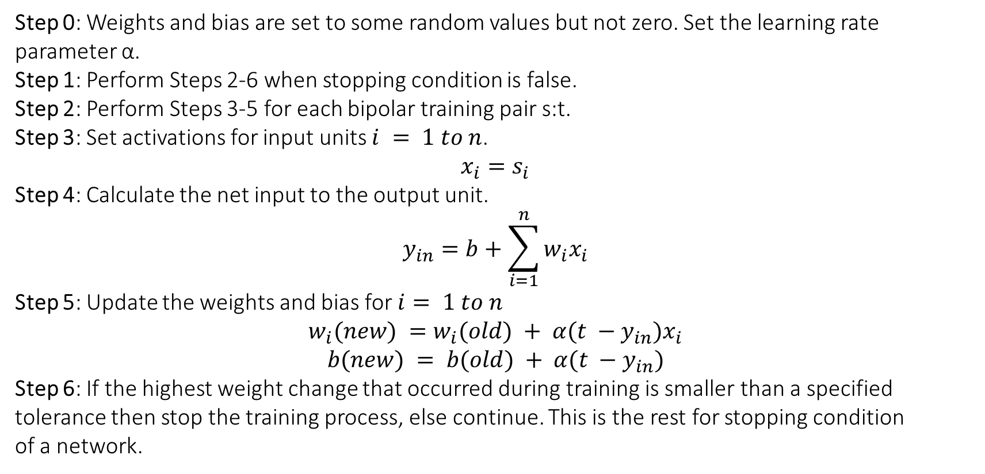
Adaline (Adaptive Linear Neural)
Step 0: Weights and bias are set to some random values but not zero. Set the learning rate
parameter α.
Step 1: Perform Steps 2-6 when stopping condition is false.
Step 2: Perform Steps 3-5 for each bipolar training pair s:t.
Step 3: Set activations for input units $i = 1 to n$.
$$x_{i}=s_{i}$$
Step 4: Calculate the net input to the output unit.
$$y_{in}=b+\sum_{i=1}^{n}{w_{i}x_{i}}$$
Step 5: Update the weights and bias for $i= 1 to n$
$$w_{i}(new) =w_{i}(old) + α(t −y_{in})x_{i}$$
$$b(new) = b(old) + α(t −y_{in})$$
Step 6: If the highest weight change that occurred during training is smaller than a specified tolerance then stop the training process, else continue. This is the rest for stopping condition
of a network.

Slide 4
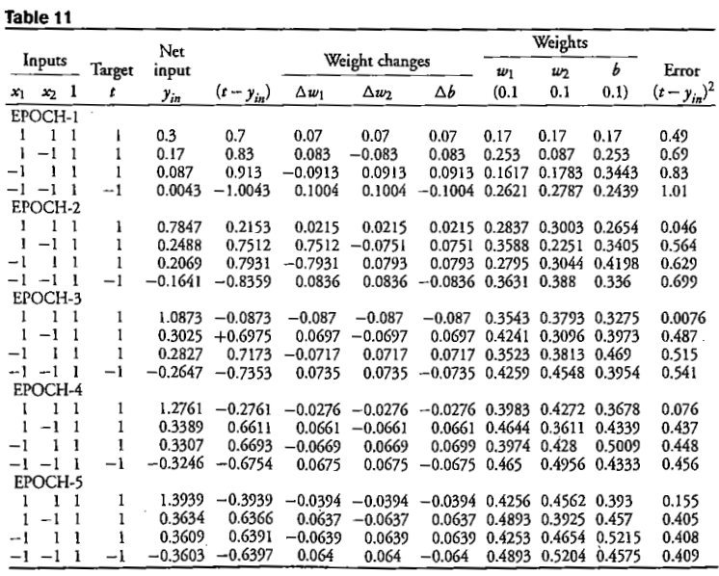
Implementation of OR function with bipolar inputs using Adaline

Slide 5
Implementation of OR function with bipolar inputs using Adaline

Slide 6
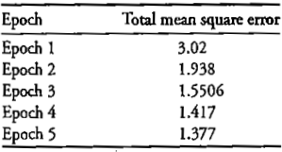
Implementation of OR function with bipolar inputs using Adaline

Slide 7
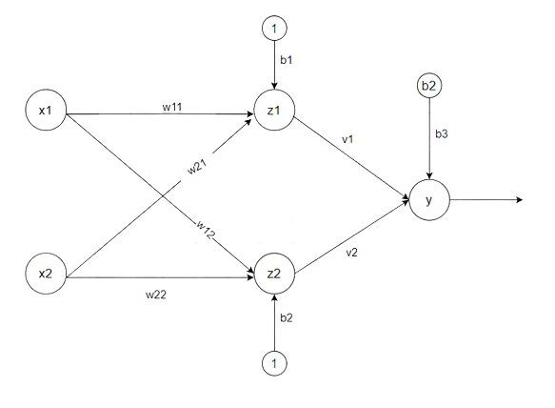
Madaline (Multiple Adaptive Linear Neuron)
The Madaline(supervised Learning) model consists of many Adaline in parallel with a single output unit.
The Adaline layer is present between the input layer and the Madaline layer hence Adaline layer is a hidden layer.
The weights between the input layer and the hidden layer are adjusted, and the weight between the hidden layer and the output layer is fixed.

Slide 8
Madaline (Multiple Adaptive Linear Neuron)
Step 1: Initialize weight and set learning rate α.
v₁=v₂=0.5 , b=0.5
other weight may be a small random value.
Step 2: While the stopping condition is False do steps 3 to 9.
Step 3: for each training set perform steps 4 to 8.
Step 4: Set activation of input unit xi = si for (i=1 to n).
Step 5: compute net input of Adaline unit
z_{in1} = b₁ + x₁w₁₁ + x₂w₂₁
z_{in2} = b₂ + x₁w12 + x₂w₂₂
Step 6: for output of remote Adaline unit using activation function given below:
Activation function f(z) =.
z₁=f(z_{in1})
z₂=f(z_{in2})

Slide 9
Madaline (Multiple Adaptive Linear Neuron)
Step 7: Calculate the net input to output.
y_{in} = b₃ + z₁v₁ + z₂v₂
Apply activation to get the output of the net
y=f(y_{in})
Step 8: Find the error and do weight updation
if t ≠ y then t=1 update weight on z(j) unit whose next input is close to 0.
if t = y no updation
w_{ij}(new) =w_{ij}(old) + α(t-z_{inj})x_{i}
b_{j}(new) = b_{j}(old) + α(t-z_{inj})
if t=-1 then update weights on all unit z_{k} which have positive net input
Step 9: Test the stopping condition; weights change all number of epochs

Slide 10
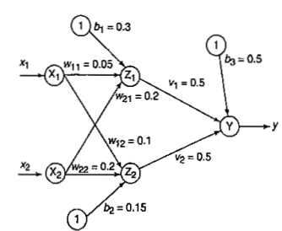
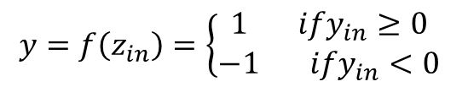
Madaline for XOR function
$$y=f\left(z_{in}\right)=\left\{\begin{aligned}1 ify_{in}≥0 \\ −1 ify_{in}<0\end{aligned}\right.$$

Slide 11
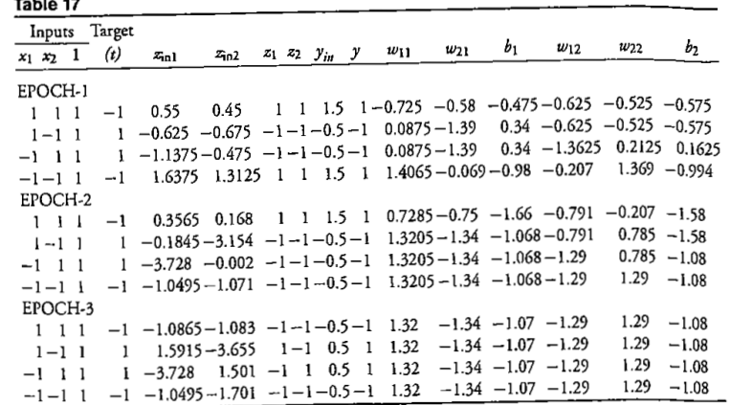
Madaline for XOR function

Slide 12
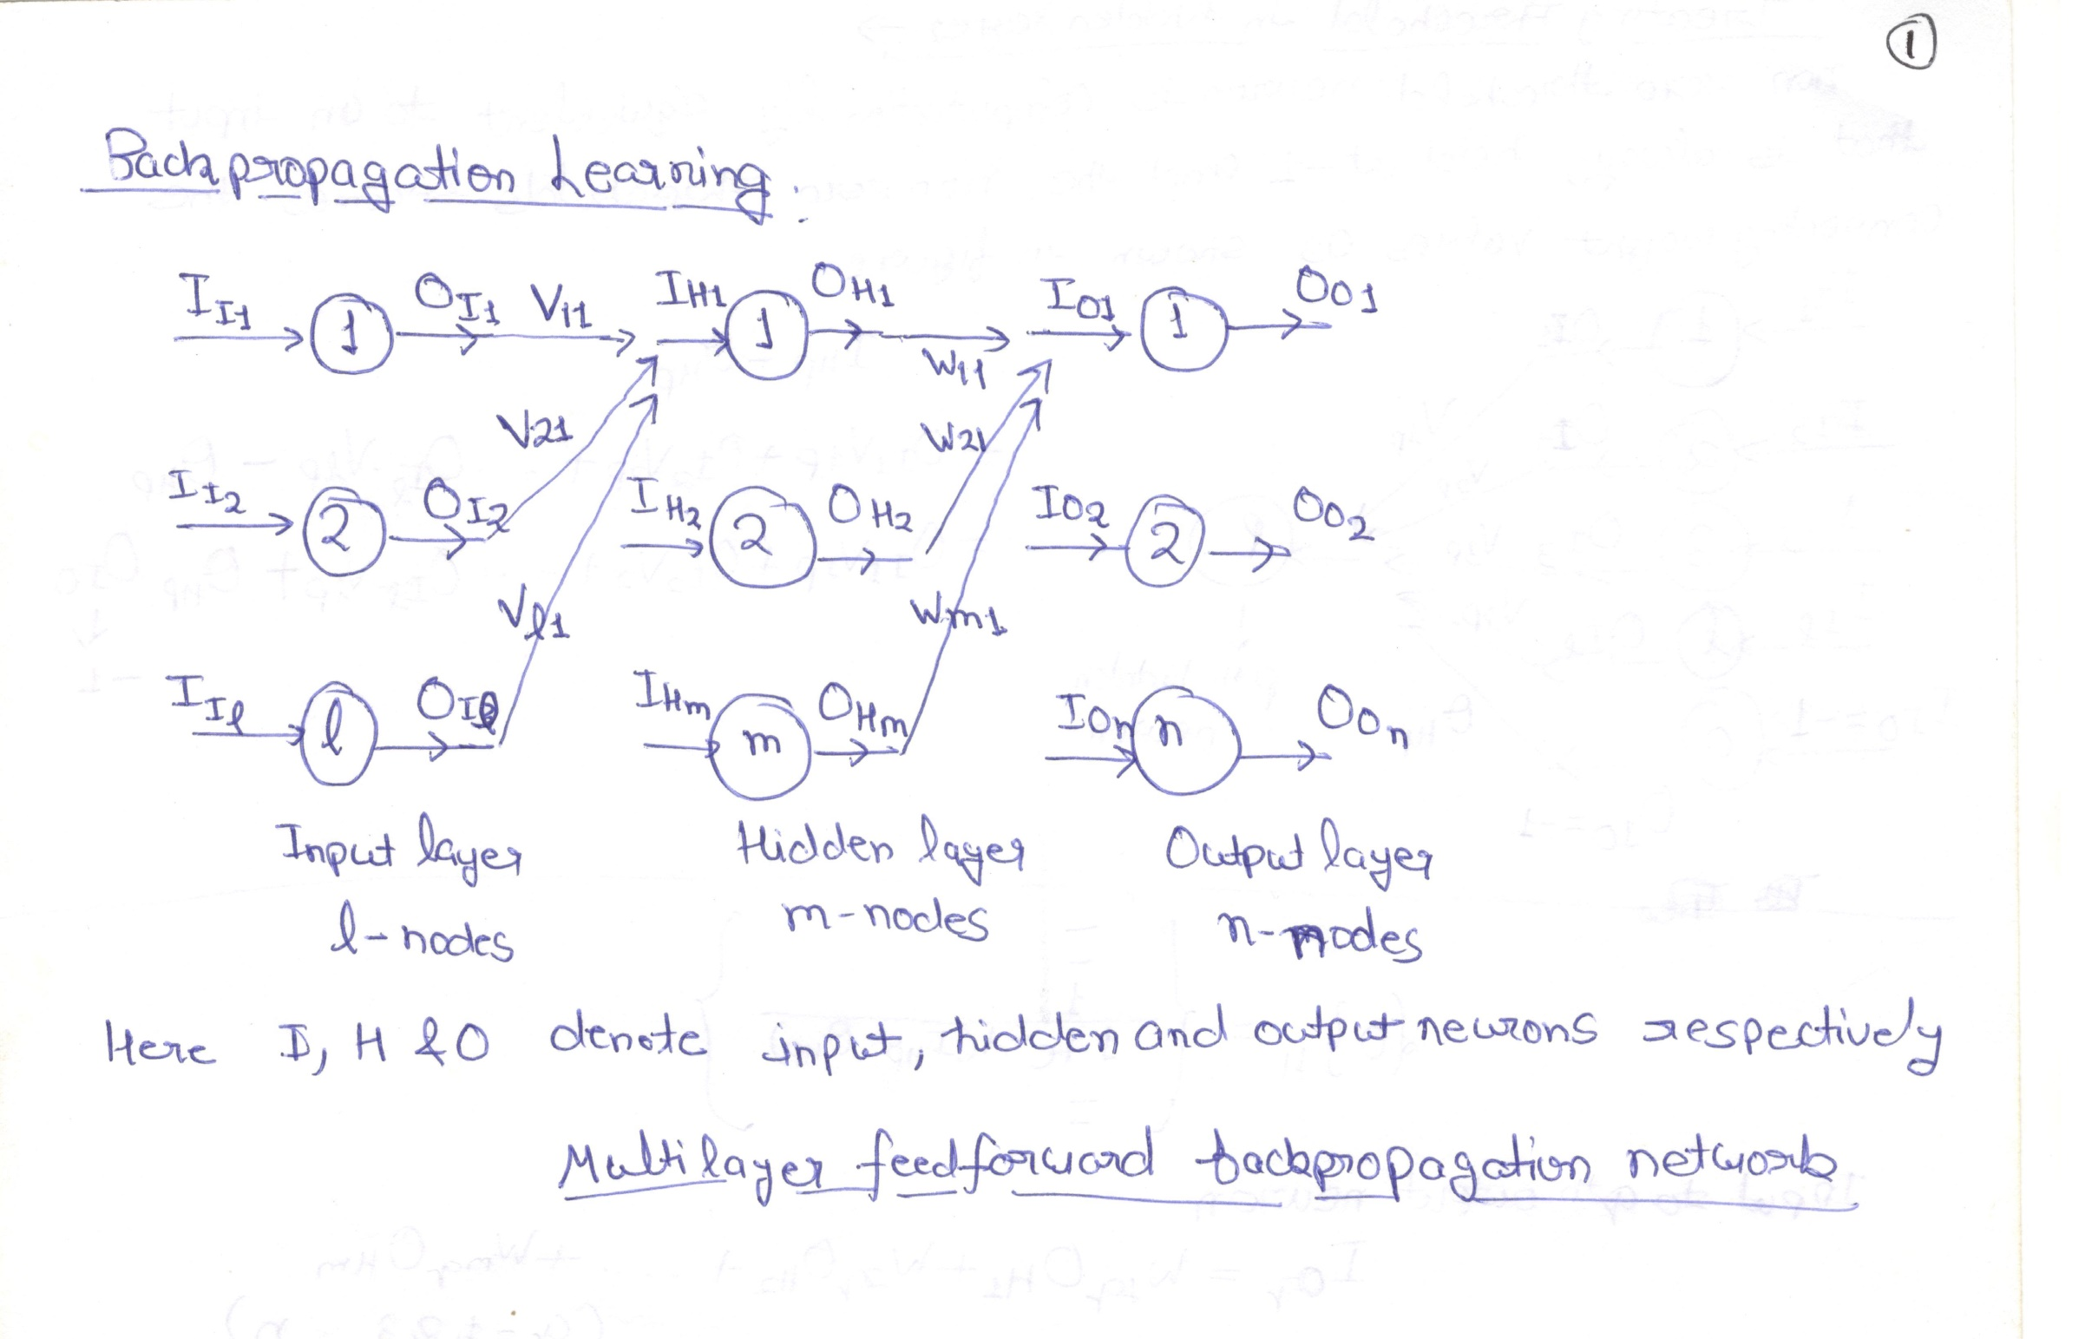
Backpropagation Network

Slide 13
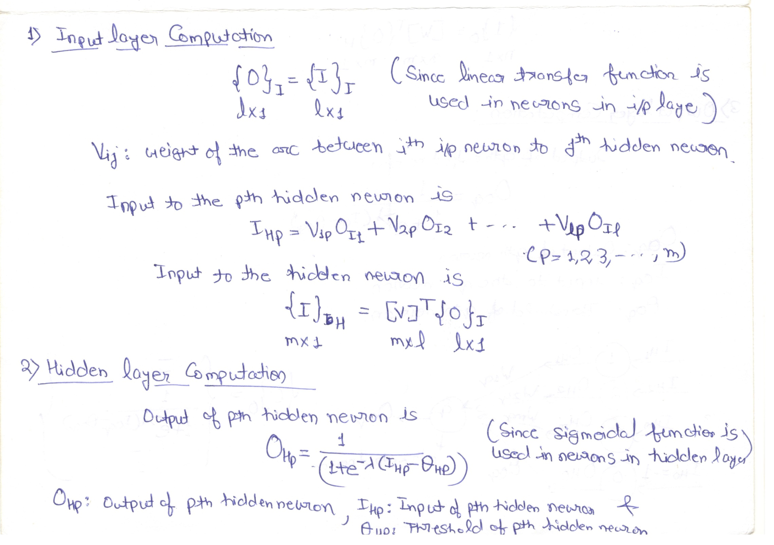

Slide 14
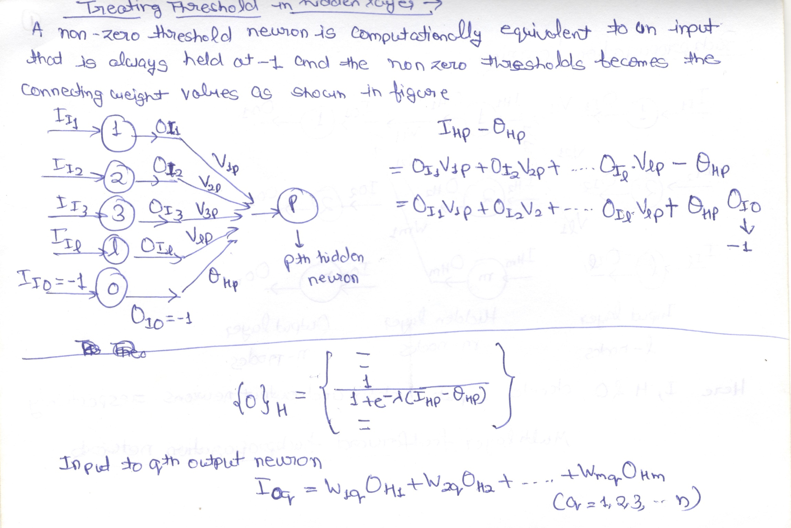

Slide 15


Slide 16
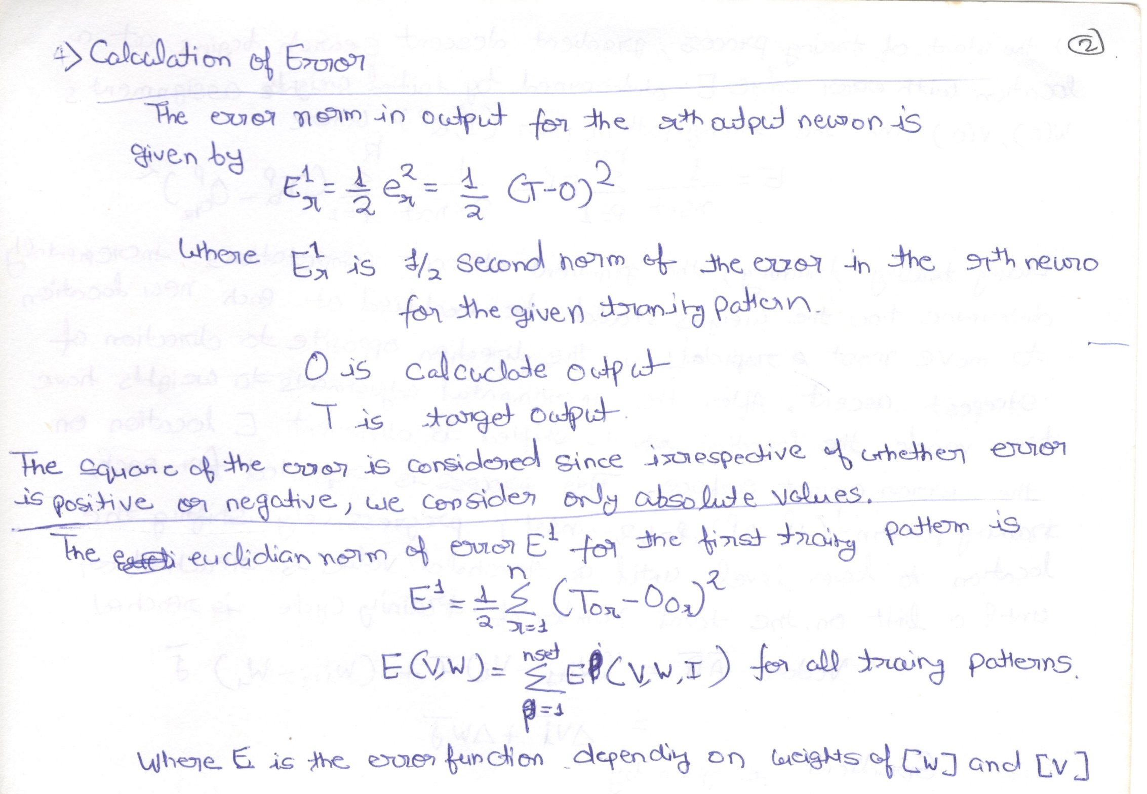

Slide 17
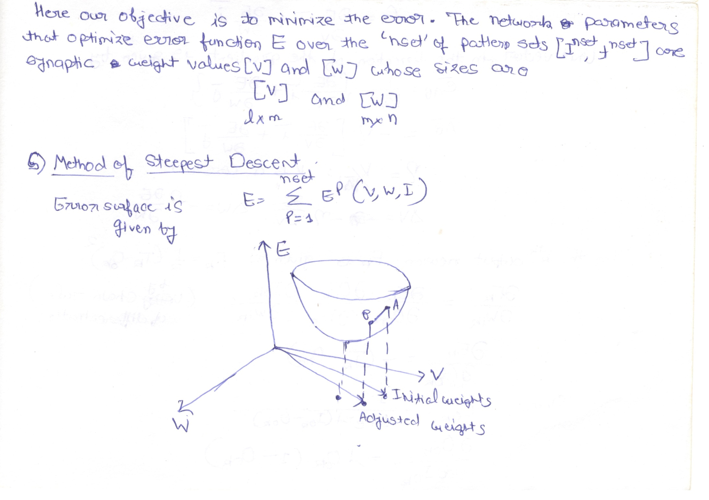

Slide 18
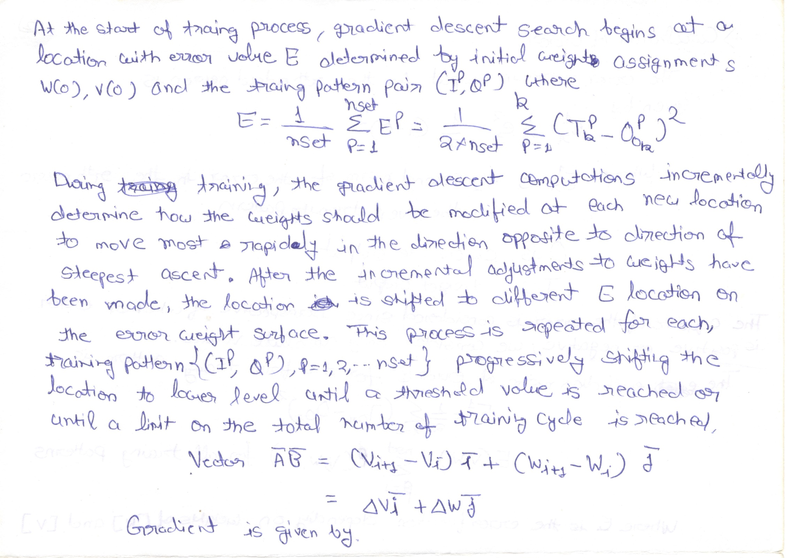

Slide 19
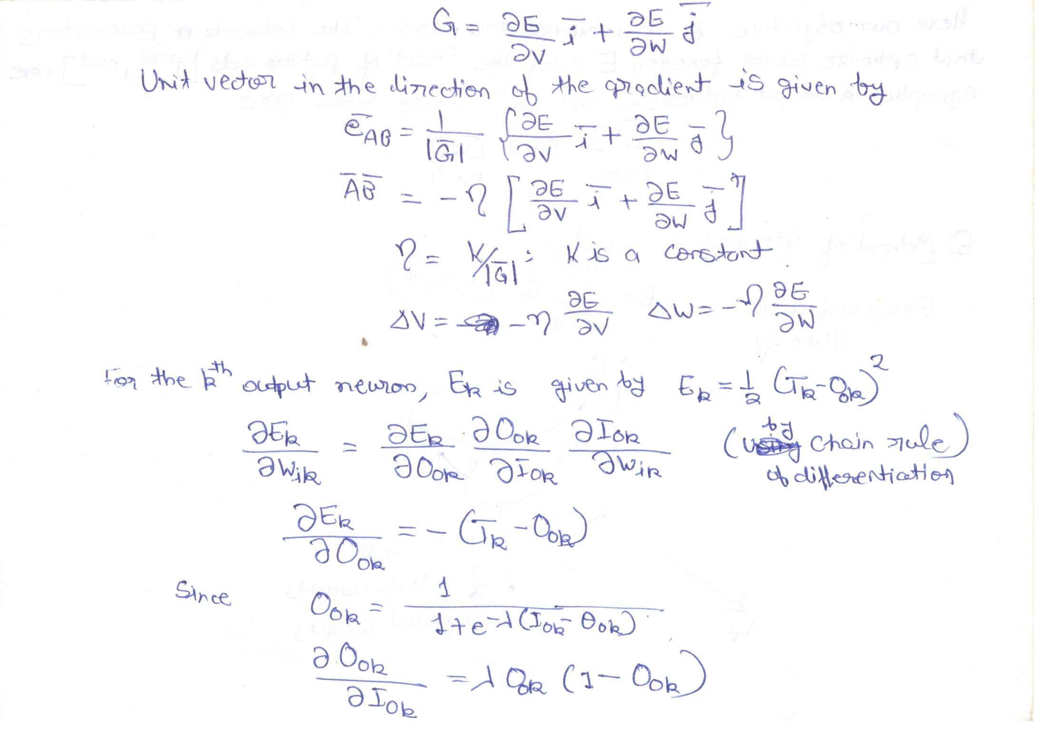

Slide 20
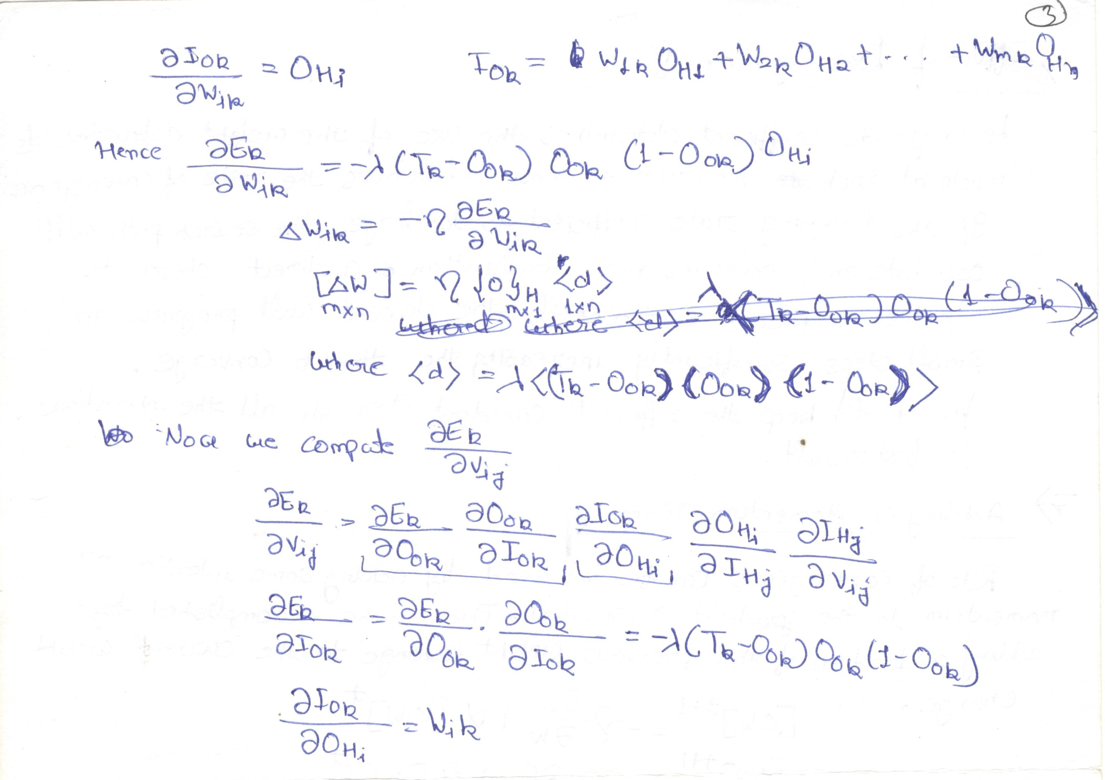

Slide 21
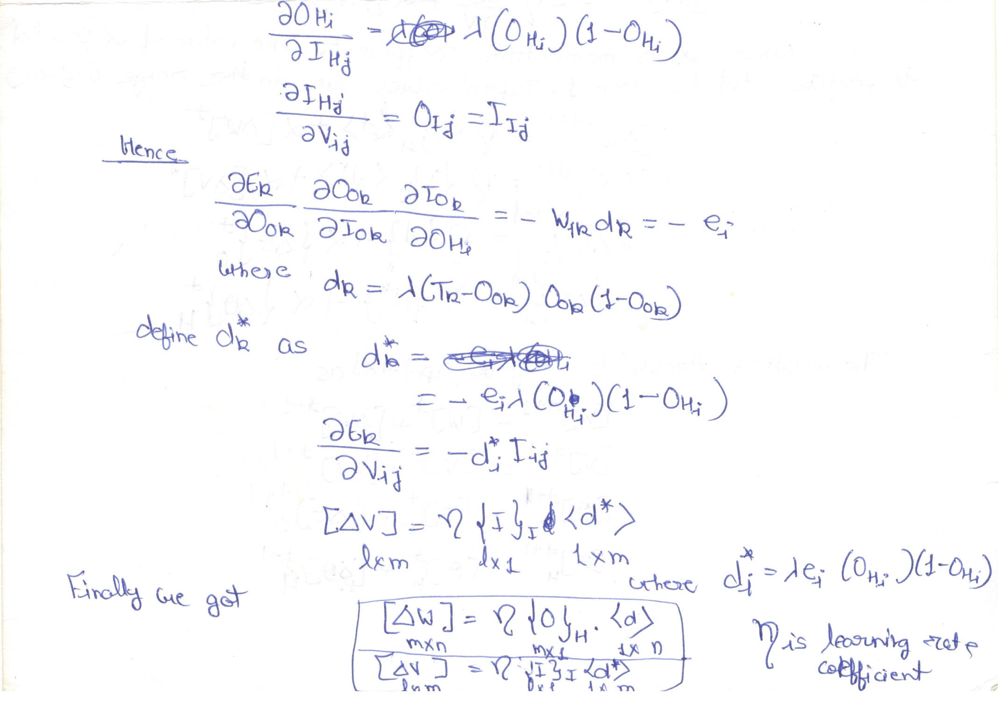

Slide 22
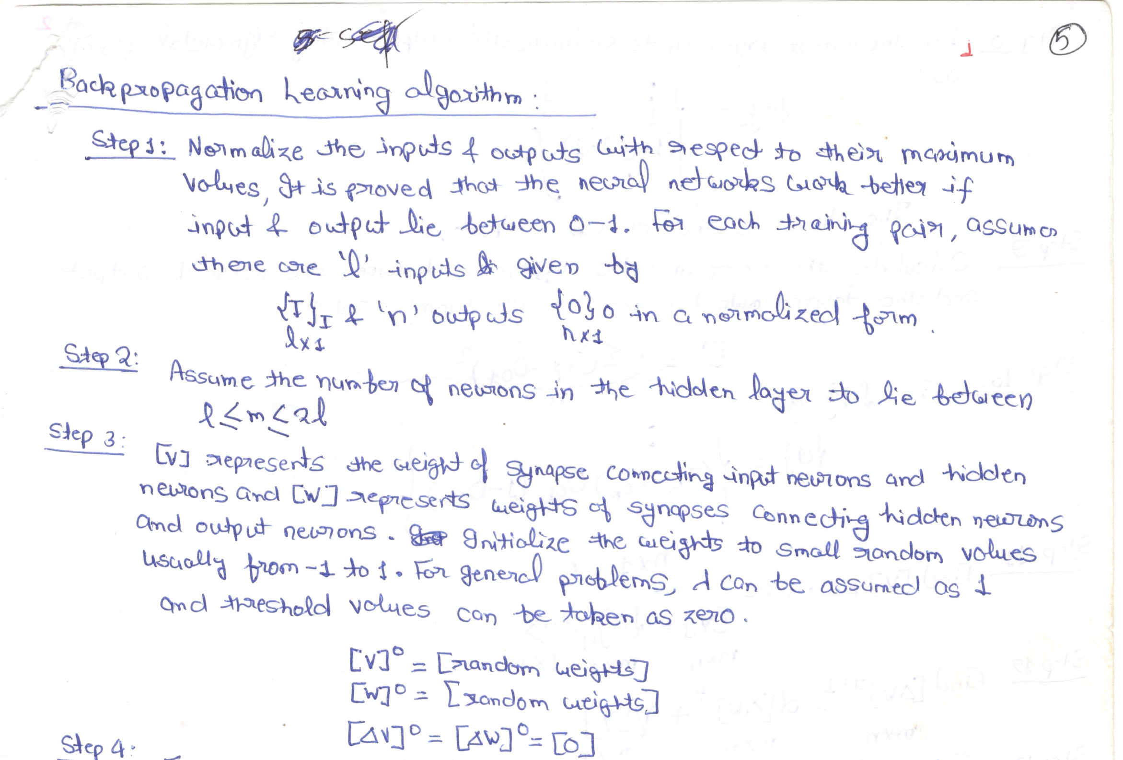

Slide 23


Slide 24
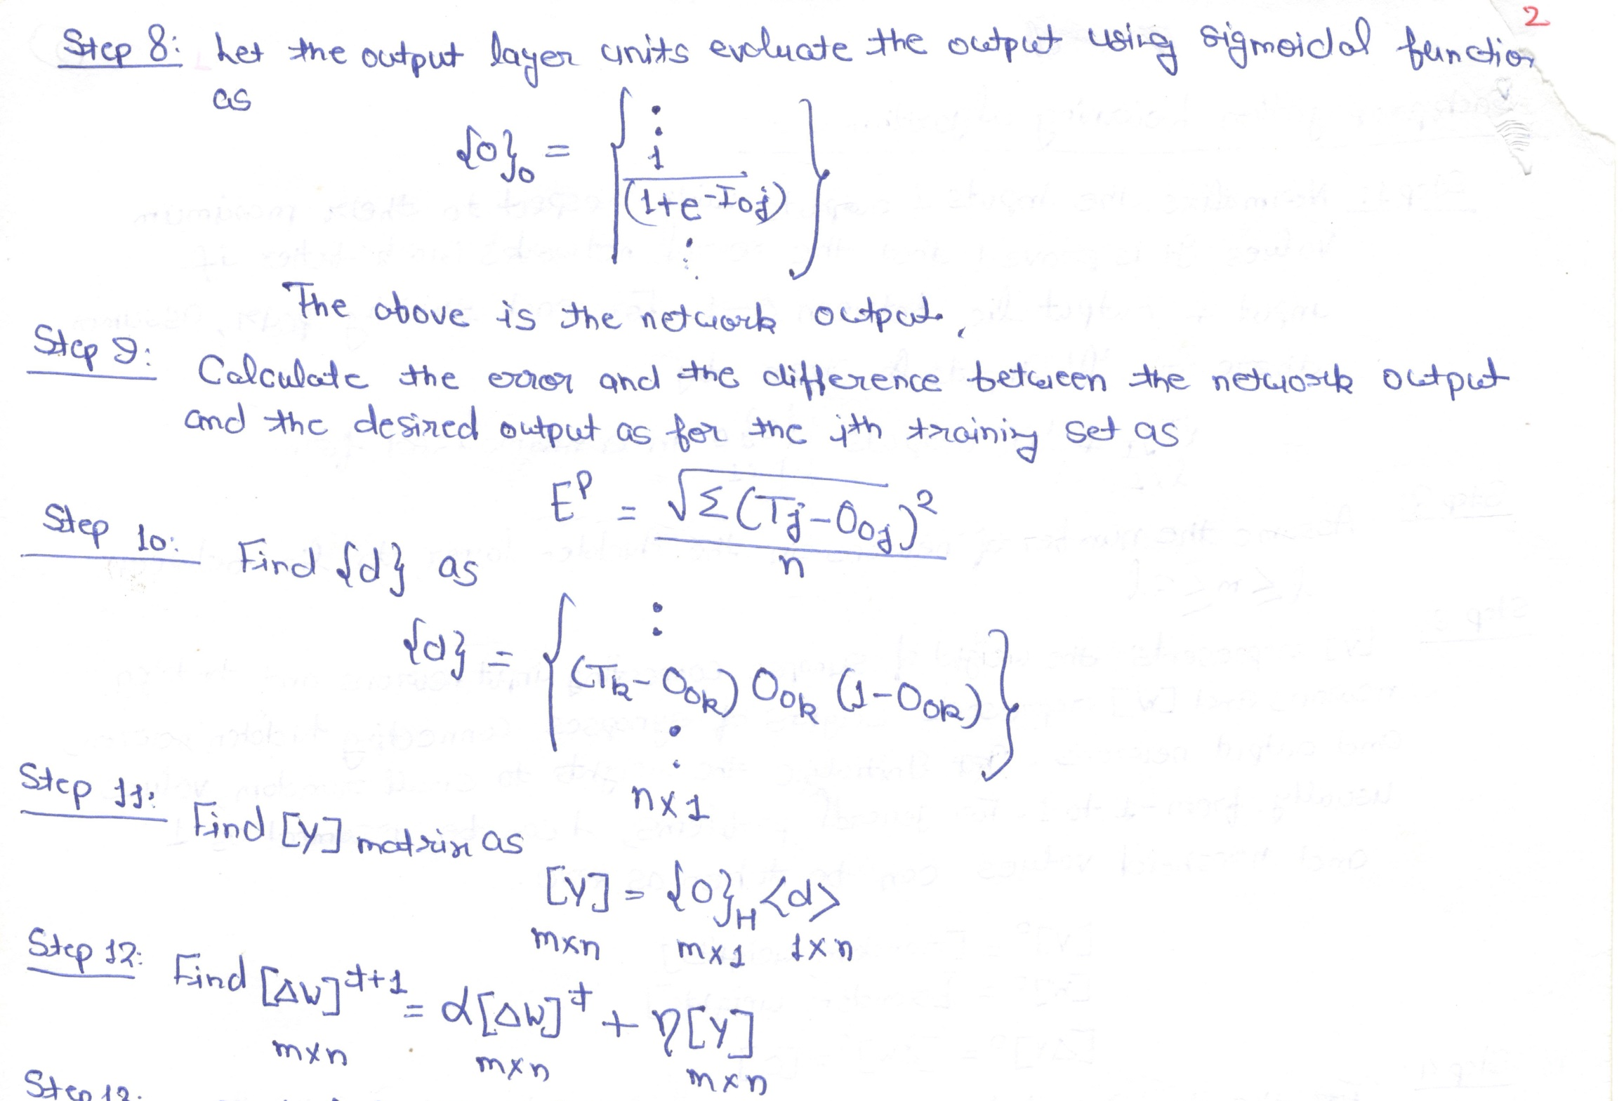

Slide 25
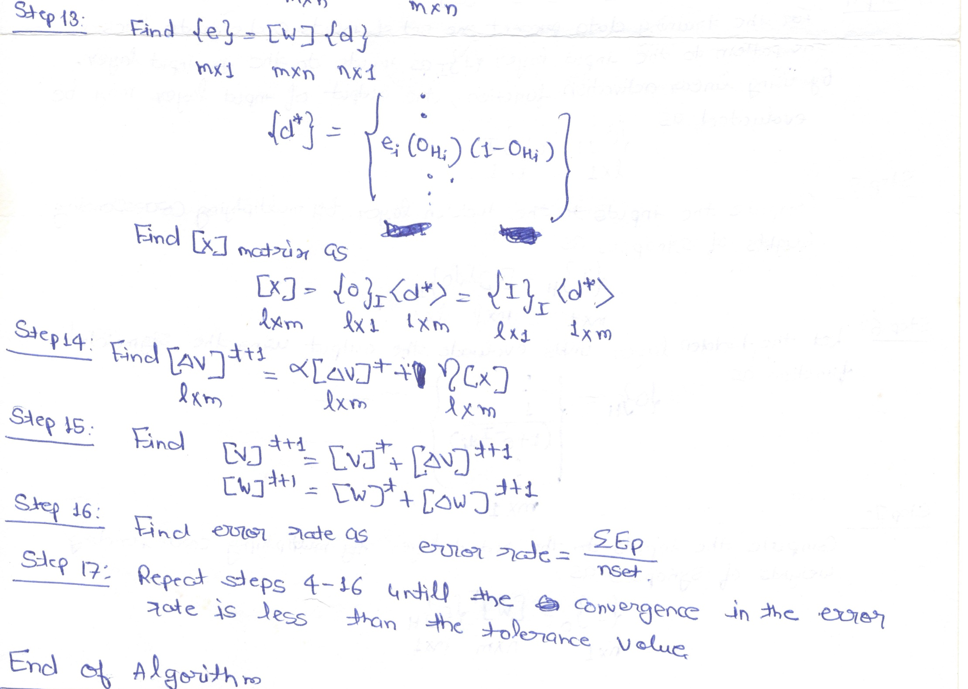

Slide 26
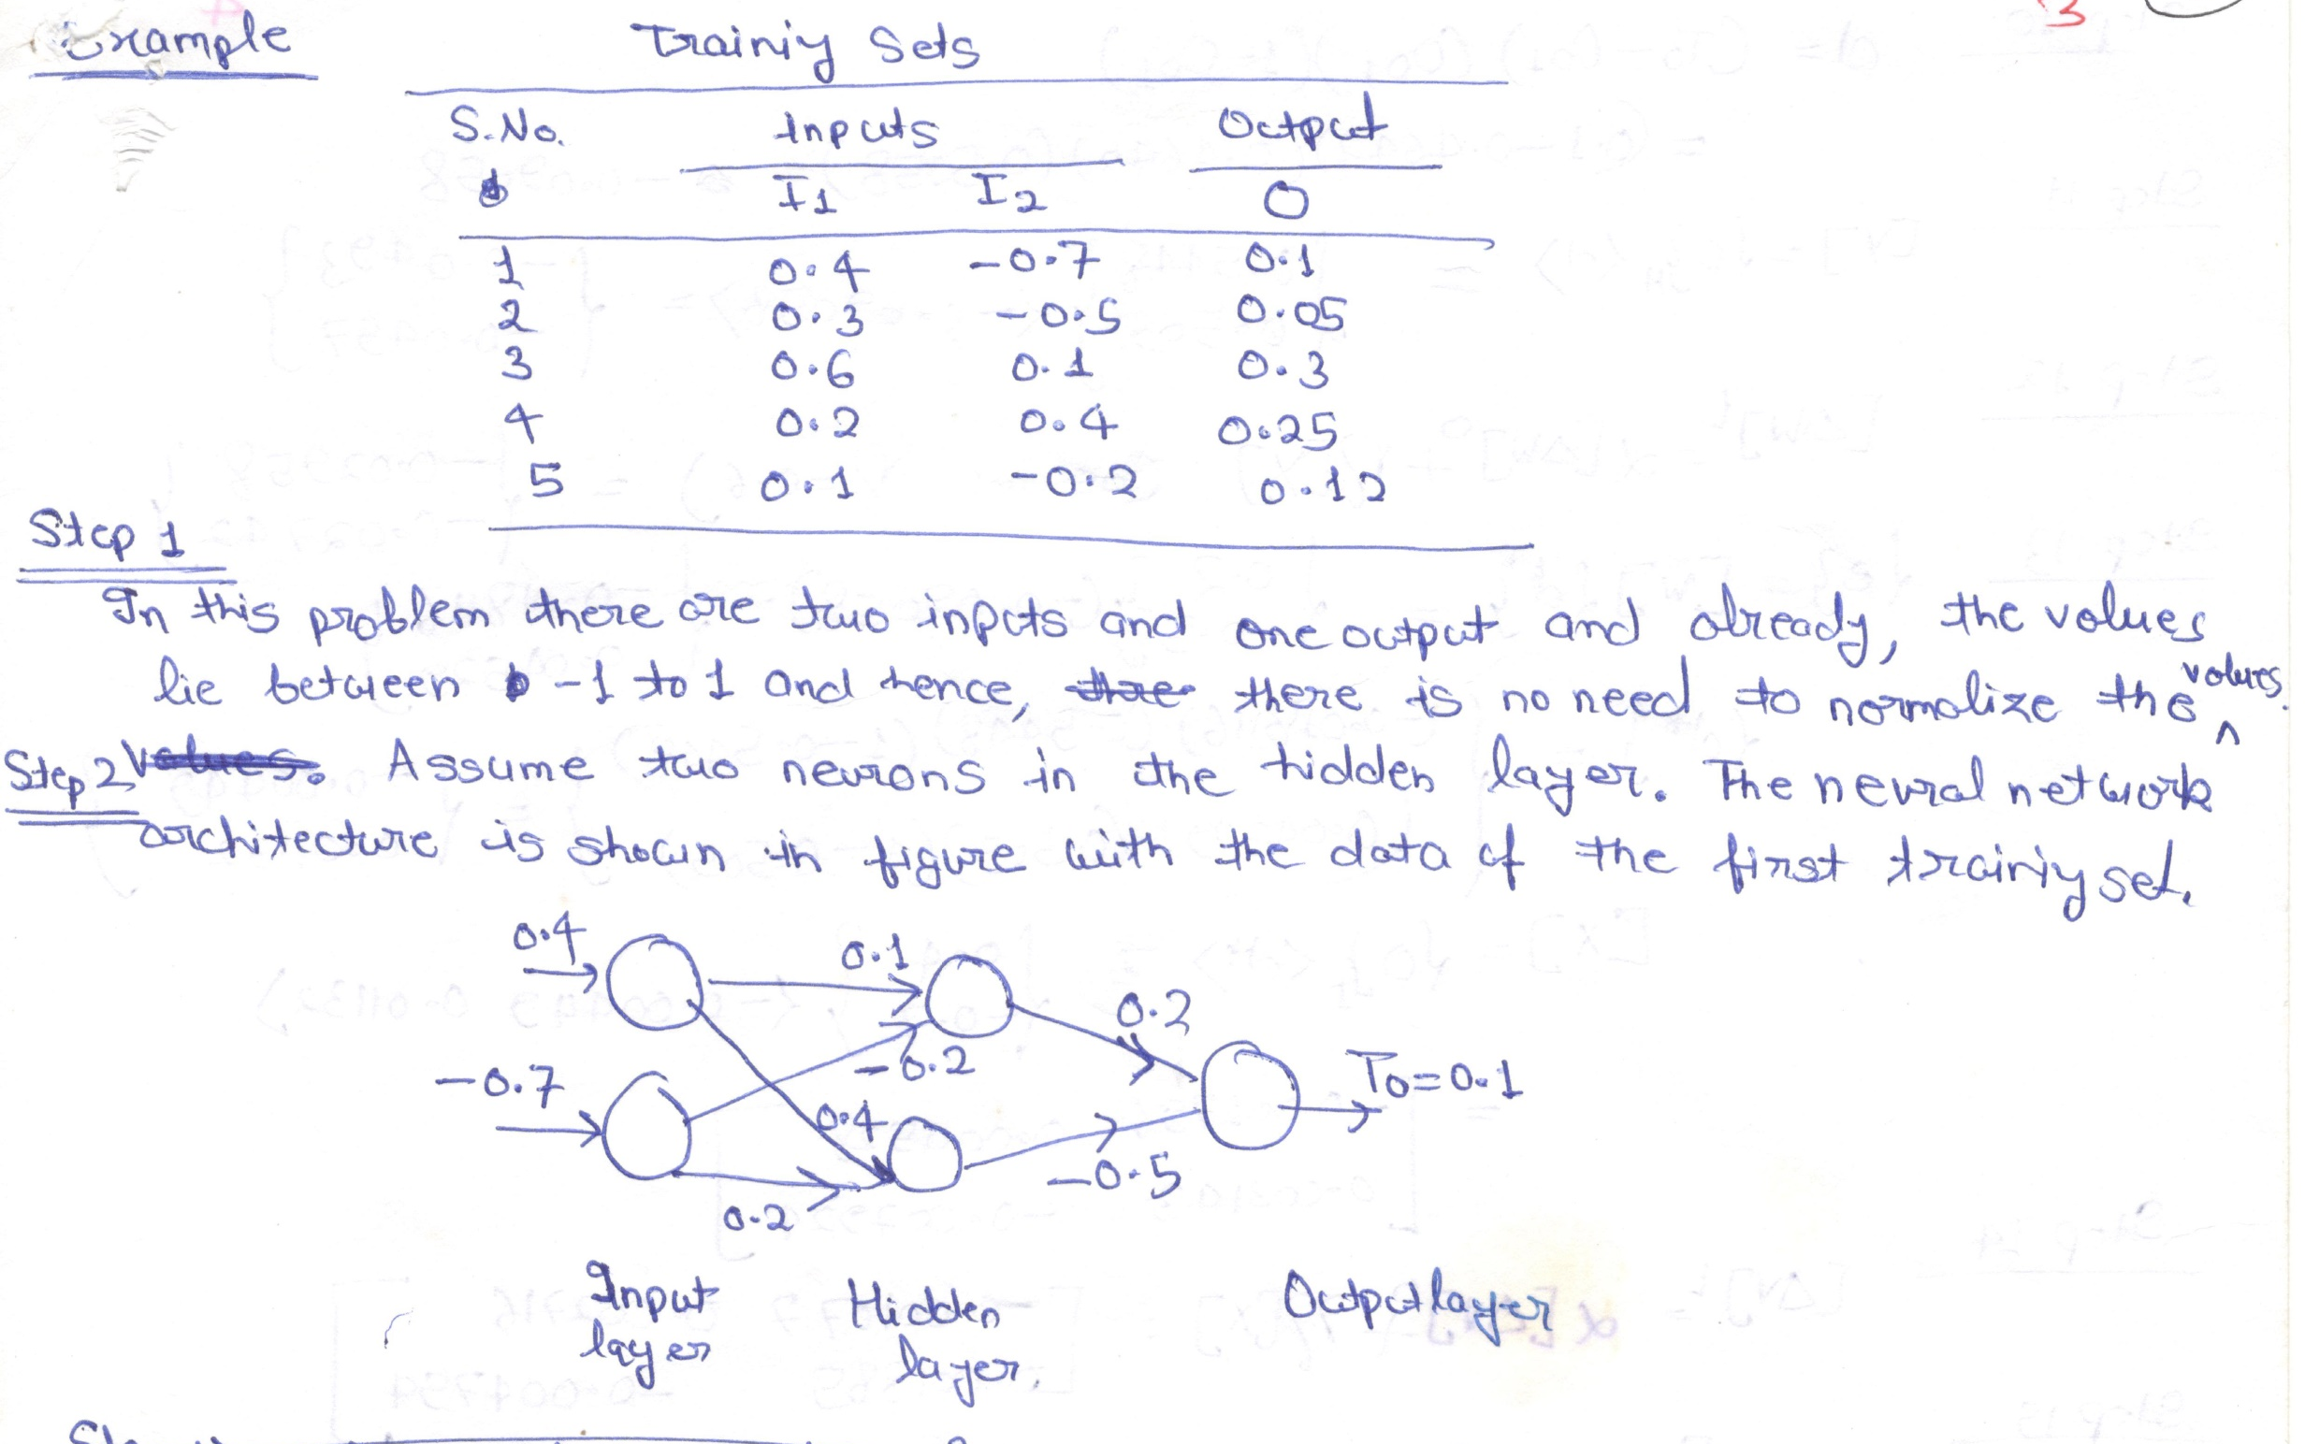

Slide 27


Slide 28
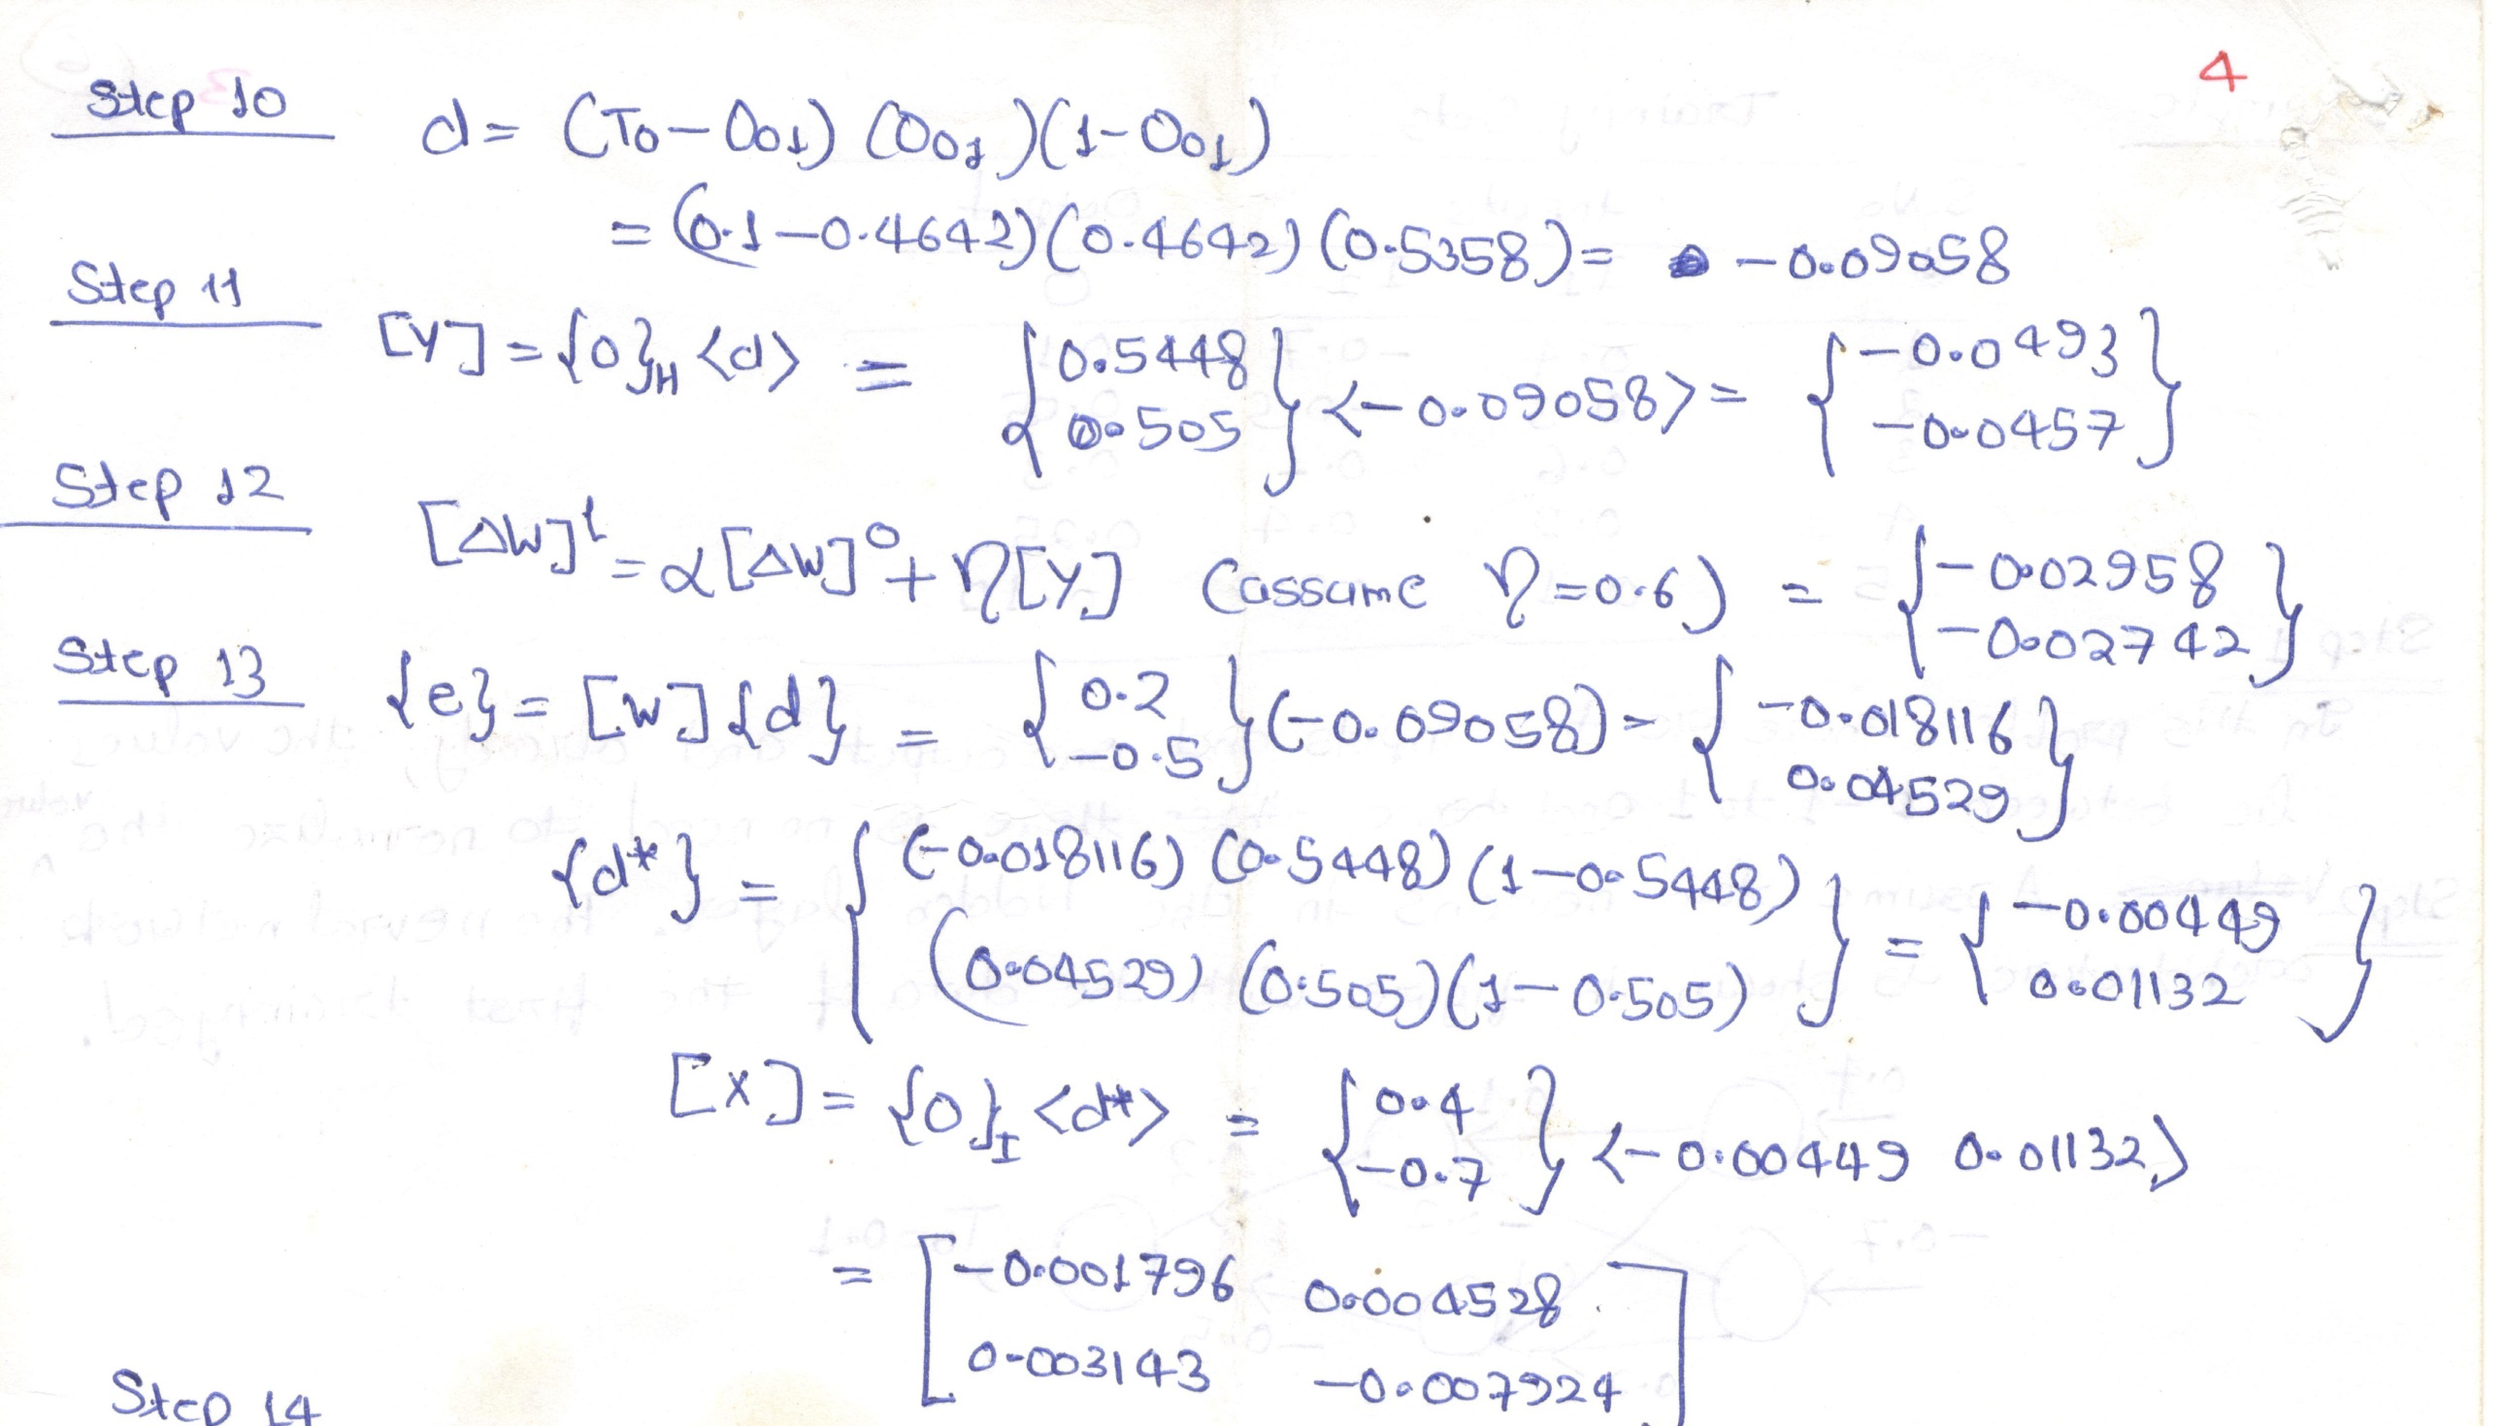

Slide 29


